Slide 1


FAKE NEWS DETECTION
Contacts:
S. AVINASH LINGAM (PGA 24)
IMARTICUS PGA 24

Slide 2
INTRODUCTION
The ease of gaining news through social media has been ever more convenient than reliable. Because humans value the convenience of distributed information, these news aren’t verified or challenged. Resulting, in people acting on fake news and further repeat this cycle of misinformation as they continue to spread false information.

Slide 3
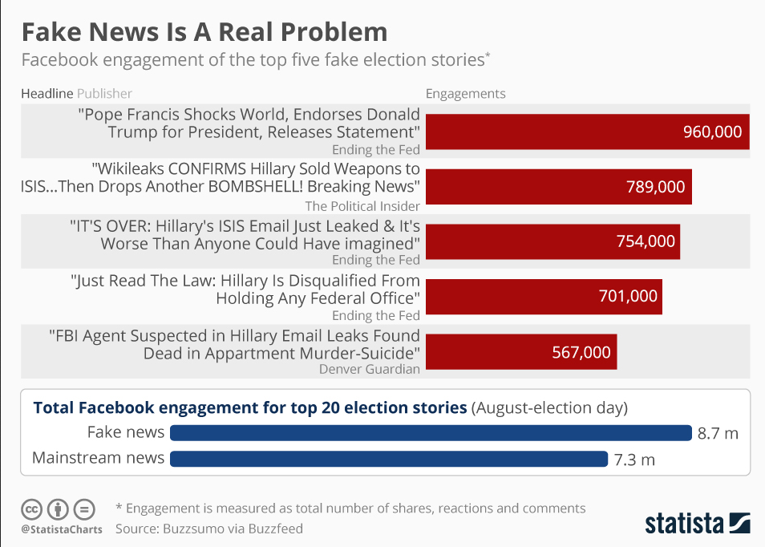

Slide 4
PROBLEM STATEMENT
In this project, we use model ensemble techniques to have better accuracy in predicting fake news using the LIAR dataset. We have also tried to simplify the problem statement into plot confusion matrix and passive aggressive classifier and deployed the same ensemble techniques to have an even better realistic approach for accurate calculation

Slide 5
ANALYTICS TOOLS
• Python
• Pandas
• Scikit-learn
• NLTK

Slide 6
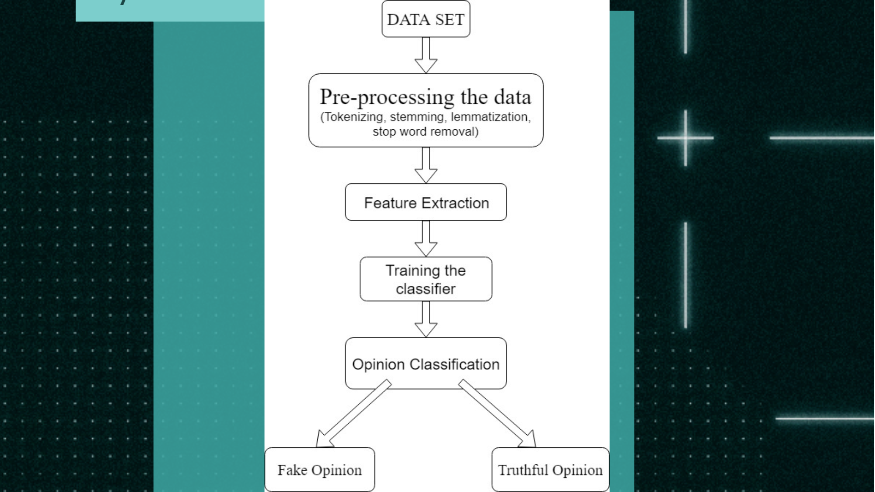
METHODOLOGY

Slide 7
RESULT AND ANALYSIS
We can evaluate machine learning algorithm using various metrics like:
Accuracy
Precision
Recall
F1-Score

Slide 8
RESULT AND ANALYSIS
Hence we evaluate and analyse the result based on these metrics for different datasets ,classifiers and different methods of feature extraction methodology.

Slide 9
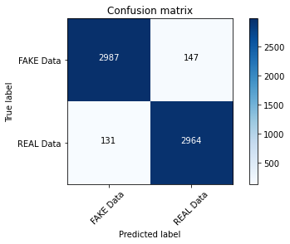
Confusion Matrix Without Normalization Accuracy 95.54%

Slide 10
CONCLUSION
Our system take input from a URL or an existing database and classify it to be true or fake. To implement this , various NLP and Machine Learning Techniques have to be used .
The growing problem of fake news only make things more complicated and tries to change or hamper the opinion and attitude of people towards use of digital technology.

Slide 11
THANK YOU

